Slide 1


The Anatomy of the Heart
Dr. Mahdi H. Hammadi
PhD Sc. Clinical Physiology

Slide 2
The Anatomy of the Heart
heart is the organ that helps supply blood and oxygen to all parts of the body. It is divided by a partition or septum into two halves, and the halves are in turn divided into four chambers. The heart is situated within the chest cavity and surrounded by a fluid filled sac called the pericardium. This amazing muscle produces electrical impulses that cause the heart to contract, pumping blood throughout the body. The heart and the circulatory system together form the cardiovascular system

Slide 3
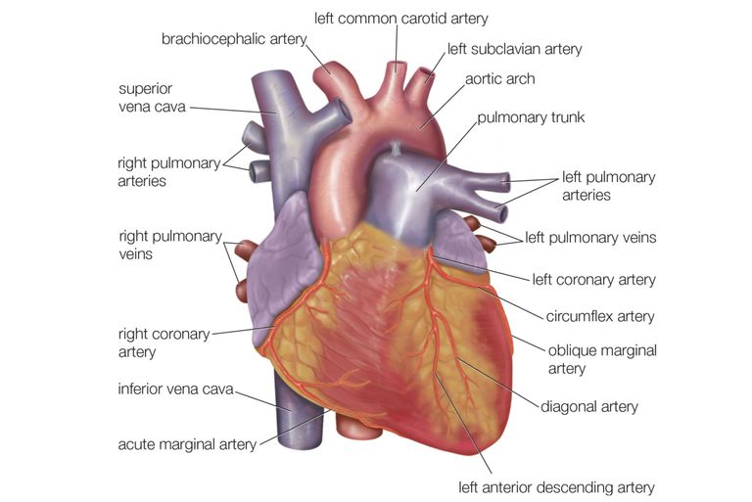

Slide 4
Chambers
Atria - upper two chambers of the heart.
Ventricles - lower two chambers of the heart.
Heart Wall
The heart wall layers:
Epicardium - the outer layer of the wall of the heart.
Myocardium - the muscular middle layer of the wall of the heart.
Endocardium - the inner layer of the heart.

Slide 5
Structure of Cardiac Muscle
Cardiac muscle fibres are shorter in length and larger in diameter than skeletal muscle fibres. They also exhibit branching, which gives an individual fibre a Y-shaped appearance. A typical cardiac muscle fibre is 50-100μm long

Slide 6
The Conduction System
Electrical impulses from your heart muscle (the myocardium) cause your heart to contract. This electrical signal begins in the sinoatrial (SA) node, located at the top of the right atrium. The SA node is sometimes called the heart’s “natural pacemaker.”

Slide 7
Cardiac Cycle
The Cardiac Cycle is the sequence of events that occurs when the heart beats. Below are the two phases of the cardiac cycle:
Diastole Phase - the heart ventricles are relaxed and the heart fills with blood.
Systole Phase - the ventricles contract and pump blood to the arteries.

Slide 8
Heart Anatomy: Valves
Heart valves are flap-like structures that allow blood to flow in one direction. Below are the four valves of the heart:

Slide 9
Blood Vessels
Blood vessels are intricate networks of hollow tubes that transport blood throughout the entire body. The following are some of the blood vessels associated with the heart:
Arteries:
Aorta - the largest artery in the body of which most major arteries branch off from.
Brachiocephalic Artery - carries oxygenated blood from the aorta to the head, neck and arm regions of the body.
Carotid Arteries - supply oxygenated blood to the head and neck regions of the body.
Common iliac Arteries - carry oxygenated blood from the abdominal aorta to the legs and feet.
Coronary Arteries - carry oxygenated and nutrient filled blood to the heart muscle.
Pulmonary Artery - carries de-oxygenated blood from the right ventricle to the lungs.
Subclavian Arteries - supply oxygenated blood to the arms.

